Slide 1

2021
Notes:
Ask about capstone presentation format.

Slide 2
Data Science and AI
Documentation
Notes:
Introductions and housekeeping
Different view of documentation

Slide 3
Why Document things?
People easily forget what was said or agreed which can lead to misunderstanding, confusion and wasted time
Trying to achieve an objective without documentation creates a very high risk of failure, job loss and reputational damage
The quality of your thinking is demonstrated by the quality of your written documentation
Other people will duplicate your work in the future if there is no documentation to rely on
Great documentation results in project approval, promotion and remains an artefact of your success for years to come
Notes:
Explain the importance of documentation. Mention that if you fail to plan, then you plan to fail.
Learning outcomes for the session are the frameworks and skills required to document appropriately and write well.
During the session students will use their capstone project and document it using these methods.
Ask Student:
Why do you use documentation?
After getting student’s answer go through the list with relevant examples.

Slide 4
Remembering Your Objective
DEFINE, DESIGN, DELIVER
You are the solution
Define the issue (problem or opportunity?)
Design the solution
Deliver the results
Notes:
Brief explanation of 3D

Slide 5
3Ds mapping to Documentation
Typical Document Sections | 3xDs stage
Background & Objectives | Define
Assumptions | Define
User Stories and Requirements | Define
Open Questions/Out of Scope | Define
Designs, Mockups, Flow Charts etc | Design
Tasks | Deliver
Results and Conclusion | Define

Slide 6
Writing Style - SAW!
Short
Sentences - use full stops. Avoid using “and”
Paragraphs - break them up. Use bold, sub-headings & lists
Active voice
Active (subject performs action): “Customers believed their account was suspended when they saw the alert”
Passive (subject receives action): “It was believed by customers that their account was suspended when they saw the alert”
We focused
Generally refer to “we” and not “I”
Notes:
Give some examples of importance of writing style. Ex: Resume, Cover Letter, Proposals.
Ask students about their idea of writing styles.
Go through the list one by one with examples.
Ask them to prepare to write.

Slide 7
When to Document
Waiting until the end of a project to write things up doesn’t work. So record and document continuously:
At the start of a project
When stakeholder feedback has been obtained
During project meetings
If a project decision has been taken - record it!
At the completion of a project
After the results of a project have been obtained

Slide 8
What to Document
Project briefs - capture verbal briefs in writing and email
Project plans - continually maintain
Meeting minutes - attendees, agenda, decisions, tasks
Designs - wire frames, flow charts, screen designs, architecture
User requirements - [persona, feature, reason]
Functional requirements - technical detail
Tasks - person and due date
Presentations - beginning, middle & end

Slide 9
Where to Document
Confluence
MS Office
Google Docs

Slide 10
How to Document
Use logical structure
Always have a beginning, middle and an end
Use a project document template
Remember to use a SAW
Remember to Define, Design and Deliver.

Slide 11
Define

Slide 12
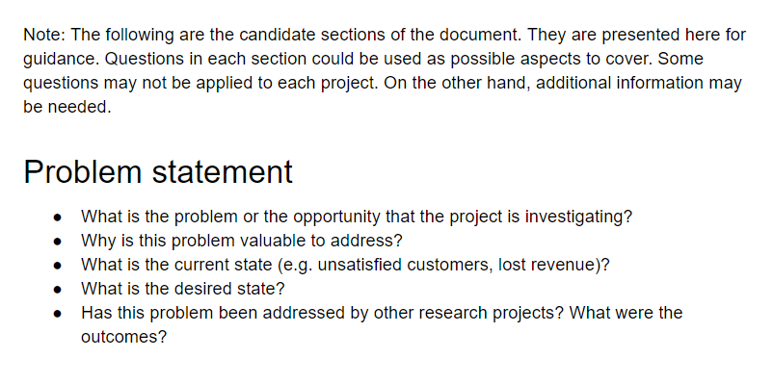
Document Macro
Notes:
Ask students to open their text editor to document their capstone.
Explain each item of table.

Slide 13
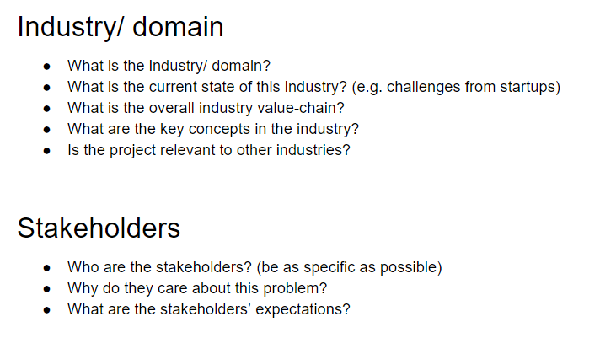
Industry and domain
Notes:
Pull out background and objective of your capstone and fill out the table.
Allow five minutes to write background & objectives.
Plugin one student’s machine to present the doc to the class.
Help them to improve their background. Background is the place where you introduce your project.
Engage other students as well by asking relevant questions.

Slide 14
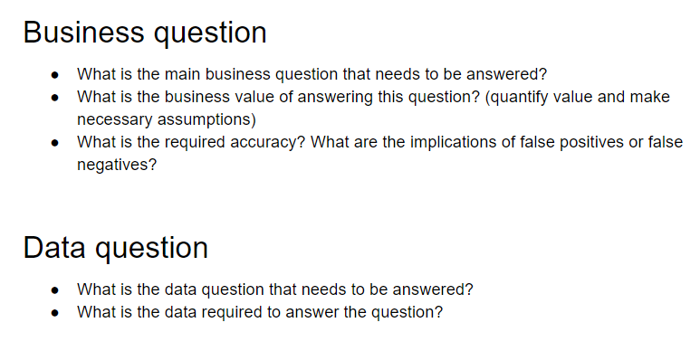
Business and Data Questions
Notes:
Allow students 3~5 minutes to write assumptions about their capstone.

Slide 15
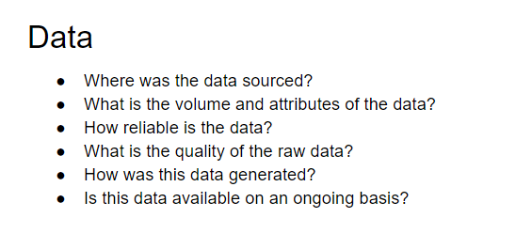
Data
Notes:
Allow user 3~5 minutes to write user stories.
Explain persona.
Share student’s screen with others. Improve / Help them to write user stories effectively.

Slide 16
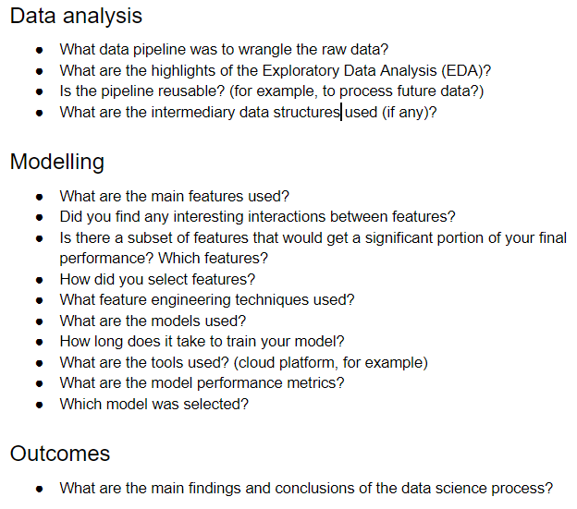
Data Science Process

Slide 17
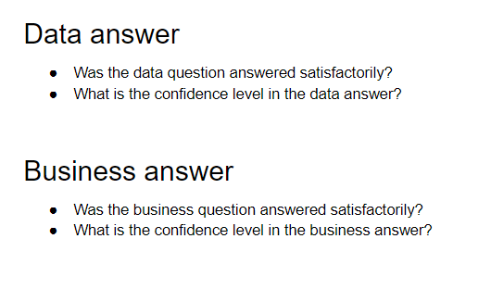
Answers

Slide 18
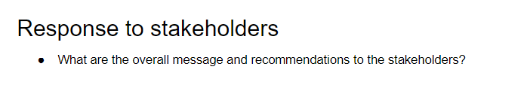
Recommendations

Slide 19
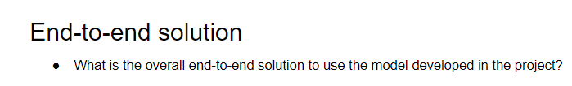
Solution

Slide 20
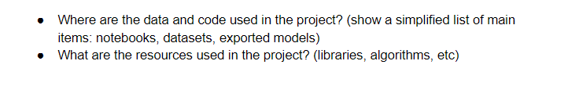
References

Slide 21
Deliver

Slide 22
How to deal with time estimates?
“How long will it take?”
Answer a question with a question - “When do you need it?”
If an executive gives you a poorly defined request and demands to know how long it will take. You can respond by saying:
“I can design & deliver something that will meet your objectives fast, but I’ll need to define the project in more detail, then I can give you an exact timeframe….
“So tell me, what is the primary objective?”
Projects should never be longer than 6-8 weeks
If projects get too long then break them into phases
A 3-month project is a warning that project definition might be poor or ill-conceived.

Slide 23
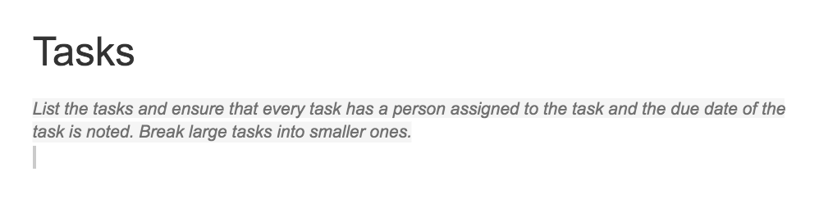
Tasks

Slide 24
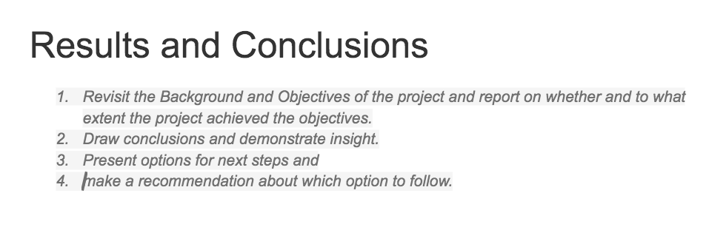
Results & Conclusions

Slide 25
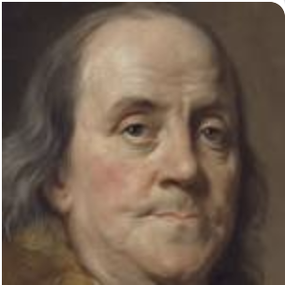
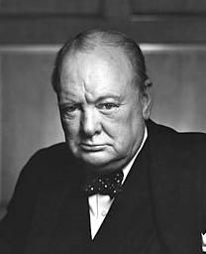
Fail to plan, plan to fail
Typical Document Sections | 3xDs stage
Background & Objectives | Define
Assumptions | Define
User Stories and Requirements | Define
Open Questions/Out of Scope | Define
Designs, Mockups, Flow Charts etc | Design
Tasks | Deliver
Results and Conclusion | Define
Notes:
Wrap up.
Benjamin Franklin said “By failing to prepare, you are preparing to fail” and later Winston Churchill modified that, rather famously, to “Failing to plan is planning to fail”.

Slide 26
Presentations and Review
Notes:
Several students to present the documents they have worked on during the class. feedback from the group.

